Slide 1
Computer Architecture
Courtsy L. N. Bhuyan

Slide 2
What is *Computer Architecture*
Computer Architecture =
  Instruction Set Architecture (Opcodes, addressing modes, architected registers, IEEE floating point) +
  Organization (High Level aspects of computer’s design i.e Memory System,bus structure ,internal CPU where arithmetic,logic ,branching and data transfers are implemented)+
  Hardware (Logic designs,Packaging technology,Clock rate,Supply voltage) + …
  Ref pp4 Patterson edition 2nd

Slide 3
Instruction Set
1) format
• length, encoding
2) operations
• operations, data types, number & kind of operands

Slide 4
Instruction Set
3) storage(Address modes)
• internal: accumulator, stack, general-purpose register
• memory: address size, addressing modes, alignments
4) control
• branch conditions, special support for procedures, predication

Slide 5
The Instruction Set: a Critical Interface
The actual programmer visible instruction set
software
instruction set
hardware

Slide 6
Instruction-Set Processor Design
Architecture (ISA) programmer/compiler view
  “functional appearance to its immediate user/system programmer”
  Opcodes, addressing modes, architected registers, IEEE floating point
Implementation (µarchitecture) processor designer/view
  “logical structure or organization that performs the architecture”
  Pipelining, functional units, caches, physical registers
Realization (chip) chip/system designer view
  “physical structure that embodies the implementation”
  Gates, cells, transistors, wires

Slide 7
Hardware
Machine specifics:
  Feature size (10 microns in 1971 to 0.18 microns in 2001)
    Minimum size of a transistor or a wire in either the x or y dimension
  Logic designs
  Packaging technology
  Clock rate
  Supply voltage
  …
Notes:
Feature size – the minimum size of a transistor or a wire in either x or y dimension.

Slide 8
Relationship Between the Three Aspects
Processors having identical ISA may be very different in organization.
  e.g. NEC VR 5432 and NEC VR 4122
Processors with identical ISA and nearly identical organization are still not nearly identical.
  e.g. Pentium II and Celeron are nearly identical but differ at clock rates and memory systems
Architecture covers all three aspects.
Notes:
NEC VR 5432 and 4122 have very different pipeline and cache organization. 4122 implement floating-point instructions in software!
Celeron is more effective for low-end computers.

Slide 9
Why Study Computer Architecture
Aren’t they fast enough already?
  Are they?
  Fast enough to do everything we will EVER want?
    AI, protein sequencing, graphics
  Is speed the only goal?
    Power: heat dissipation + battery life
    Cost
    Reliability
    Etc.
Answer #1: requirements are always changing

Slide 10
Example of Changing Designs
Having, or not having caches
  1970: 10K transistors on a single chip, DRAM faster than logic → having a cache is bad
  1990: 1M transistors, logic is faster than DRAM → having a cache is good
  2000: 600M transistors -> multiple level caches and multiple CPUs
  Will caches ever be a bad idea again?

Slide 11
Example of Changing Designs
During 1970s, Mainframes and minicomputers dominated the industry
Performance improved 25% to 30% per year due to improved
  architectures and technological developments
Late 1970s –microprocessor came (Improvement in ICTechnology) which led to higher rate of improvement – roughly 35% growth per year in performance

Slide 12
Design Changes contd..
Microprocessor based computers became Commercially successful due to
  Mass production of microprocessors
  Portable object-code creation techniques (cross compilers:-each new architecture required time consuming assembly language programming previously)
  Creation of standardized vendor-independent operating systems, such as UNIX and its clone, Linux

Slide 13
Design Changes contd..
In the early 1980s, development of a new set of architectures
  RISC (Reduced Instruction Set Computer)
    RISC-based machines focused critical performance techniques
      Exploitation of instruction level parallelism (pipelining, multiple instruction issue)
      Use of caches

Slide 14
Performance Growth in Perspective
Same absolute increase in computing power
  Big Bang – 2001
  2001 – 2003
1971 – 2001: performance improved 35,000X!!!
  What if cars or planes improved at this rate?

Slide 15
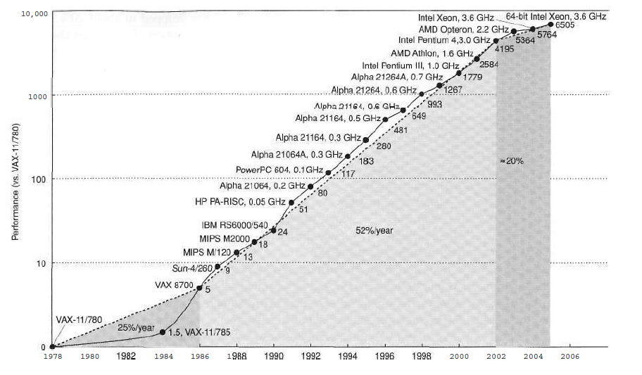
Uniprocessor

Slide 16
processor per Chip
Multi
Instruction Level Parallelism ILP(started on Uni-processor)
  compiler and hardware used it
Thread Level Parallelism(TLP) and Data Level Parallelism (DTL)
  Explicitly parallel
    Require programmer to write code to gain performance

Slide 18
Applications and Requirements
Scientific/numerical: weather prediction, molecular modeling
  Need: large memory, floating-point arithmetic
Commercial: inventory, payroll, web serving, e-commerce
  Need: integer arithmetic, high I/O
Embedded: automobile engines, microwave, PDAs
  Need: low power, low cost, interrupt driven
Home computing: multimedia, games, entertainment
  Need: high data bandwidth, graphics

Slide 19
Classes of Computers
High performance (supercomputers-going towards cluster of Low cost/power)
  Supercomputers – Cray T-90
  Massively parallel computers – Cray T3E
Balanced cost/performance (high reliability,scalability)
  Workstations – SPARCstations
  Servers – SGI Origin, UltraSPARC
  High-end PCs – Pentium quads
Low cost/power
  Low-end PCs, laptops, PDAs – mobile Pentiums

